Slide 1
How to allow physical item requests only for items "on shelf"
Yoel Kortick
Senior Librarian

Slide 2
Introduction
Create or identify TOUs which do and do not allow requests
Create request rules so that only on shelf items are requestable
Sample items to test
Try it out

Slide 3
Introduction

Slide 4
Introduction
This presentation will present a solution for the following situation:
The institution wants to allow for physical item requesting but only for items which are on the shelf (available).
Items which are on loan, in transit, etc. will not have an option for request.

Slide 5
Create or identify TOUs which do and do not allow requests

Slide 6
Create or identify TOUs which do and do not allow requests
As part of the solution we will need two TOUs (Terms of Use):
One which does allow requests
One which does not allow request
View the terms of use at "Configuration > Fulfillment > Physical Fulfillment > Terms of Use and Policies"

Slide 7
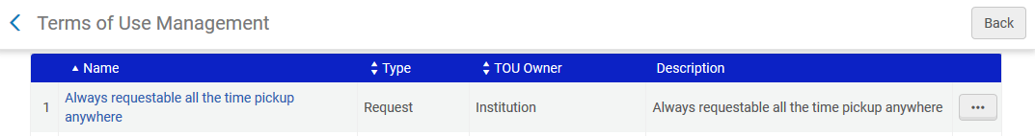
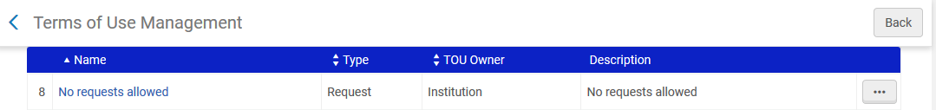
Create or identify TOUs which do and do not allow requests
Here are the two Terms Of Use

Slide 8
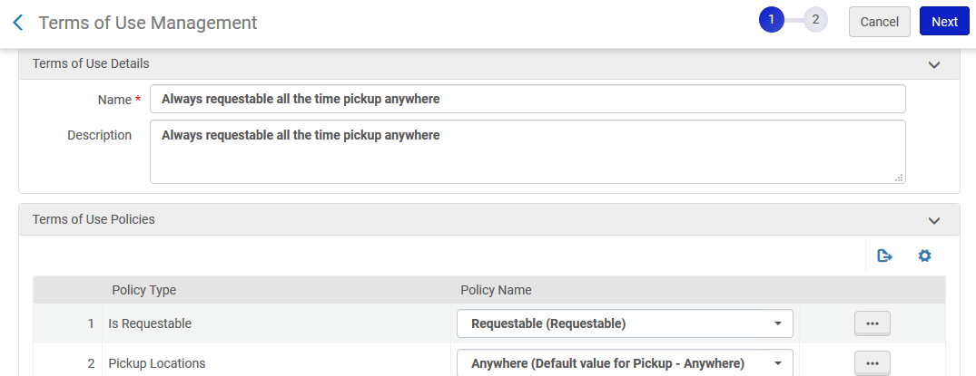
Create or identify TOUs which do and do not allow requests
Here is the first Terms Of Use "Requestable"
For other parameters such as pickup location define whatever you want

Slide 9
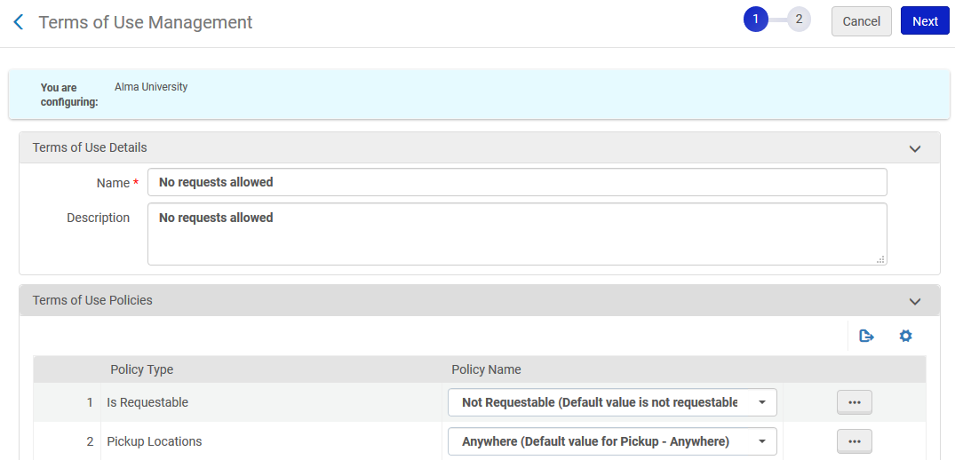
Create or identify TOUs which do and do not allow requests
Here is the second Terms Of Use "Not Requestable"
For other parameters such as pickup location define whatever you want

Slide 10
Create request rules so that only on shelf items are requestable

Slide 11
Create request rules so that only on shelf items are requestable
Access the fulfillment until rules of type request and make a set of rules which state: "If the item is in the shelf then allow requests otherwise do not allow requests". This is done as follows
Access the relevant fulfillment unit at "Configuration > Fulfillment > Physical Fulfillment > Fulfillment Units"
Then switch to the "Fulfillment Unit Rules" tab of the fulfillment unit and choose type "Requests"
Add a new rule

Slide 12
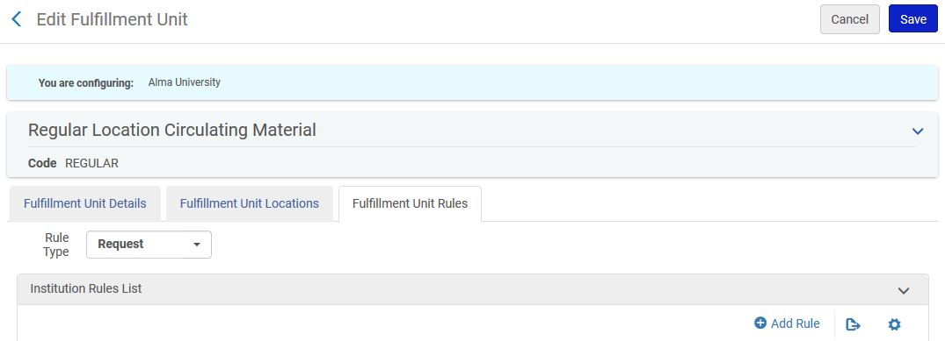
Create request rules so that only on shelf items are requestable

Slide 13
Create request rules so that only on shelf items are requestable
Create a fulfillment until rule for requests which uses name "process type" and operator "In List" and value "all process types". Make the output be the TOU which does not allow hold requests. This way hold requests will not be allowed for unavailable items. Disable all other rules (disable instead of delete so that later they can easily be returned).

Slide 14
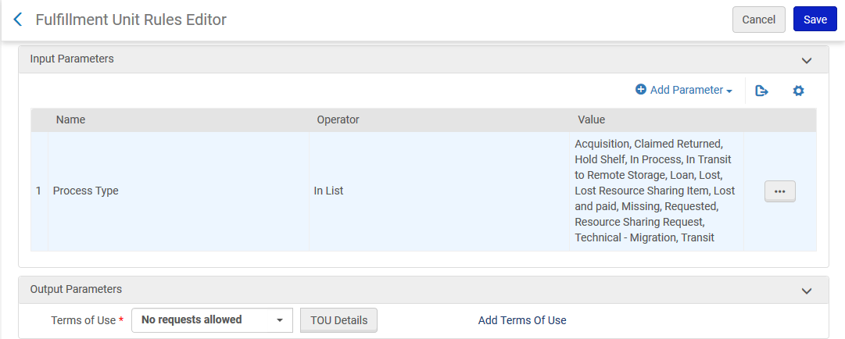
Create request rules so that only on shelf items are requestable
For all process types
Requests are not allowed

Slide 15
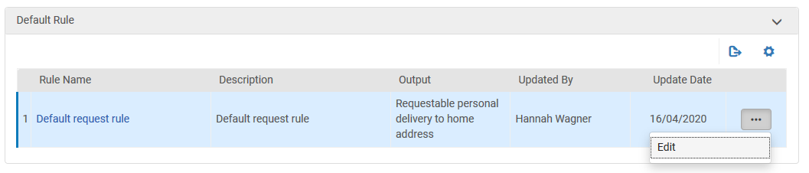
Create request rules so that only on shelf items are requestable
Edit the default fulfillment unit rule for requests so that requests are allowed. This way the system will first check via the previous rule if there is a process status. If there is a process status then requests will not be allowed. If there are no process types (item is on shelf) then requests will be allowed.
Edit the default rule …

Slide 16
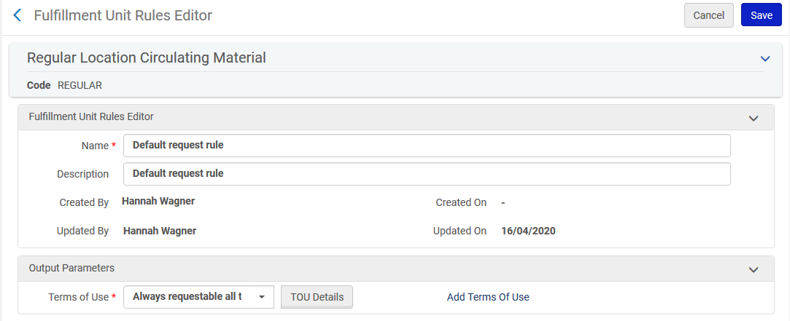
Create request rules so that only on shelf items are requestable
Default request rule
Requests are always allowed

Slide 17
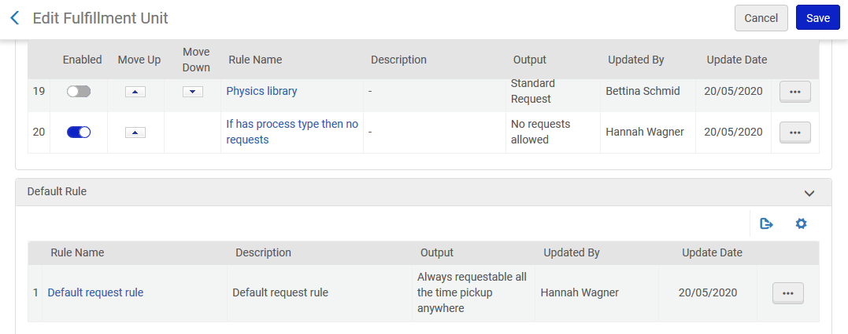
Create request rules so that only on shelf items are requestable
Now we have one active rule that states "if there is a process status then no requests allowed" and a default rule stating "request allowed"
This is the only active rule

Slide 18
Sample items to test

Slide 19
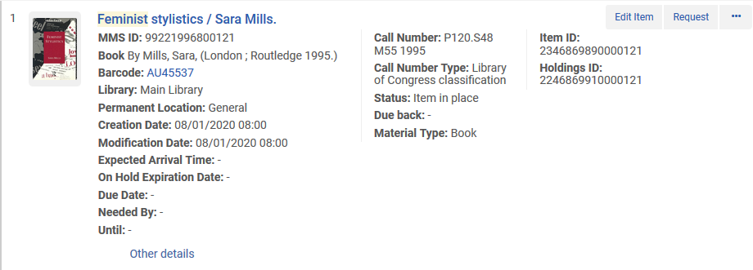
Sample items to test
Item barcode AU45537 title "Feminist stylistics" is "In Place“. It should be requestable.

Slide 20
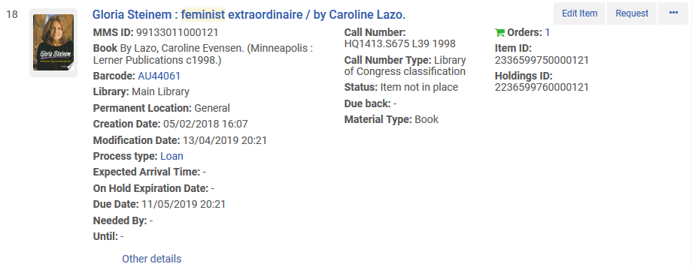
Sample items to test
Item barcode AU44061 title "Gloria Steinem : feminist extraordinaire" is "Not in place" and "On Loan“. It should not be requestable.

Slide 21
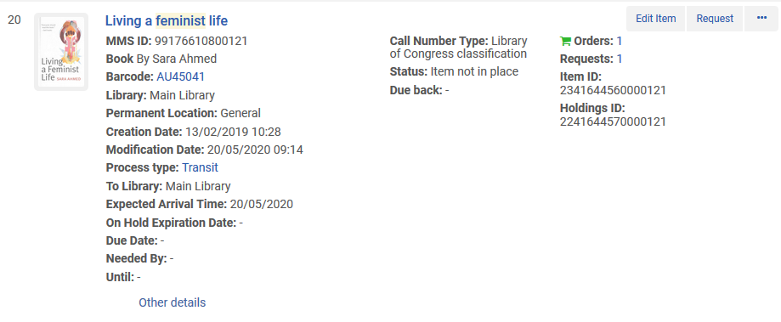
Sample items to test
Item barcode AU45401 title "Living a feminist life" is "Not in place" and "In Transit“. It should not be requestable.

Slide 22
Try it out

Slide 23
Try it out
Here is what we expect to happen:
Item barcode AU45537 title "Feminist stylistics" is "In Place" and therefore can be requested
Item barcode AU44061 title "Gloria Steinem : feminist extraordinaire" is "Not in place" and "On Loan" and therefore cannot be requested
Item barcode AU45401 title "Living a feminist life" is "Not in place" and "In Transit" and therefore cannot be requested

Slide 24
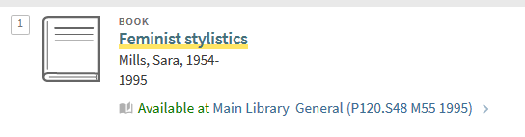
Try it out
User Alicia Chen has logged into Primo and searches for title "Feminist stylistics" and clicks the physical availability link

Slide 25
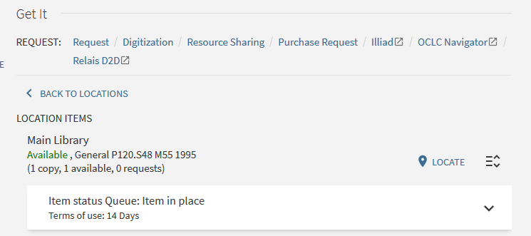
Try it out
She clicks the "Request" link

Slide 26
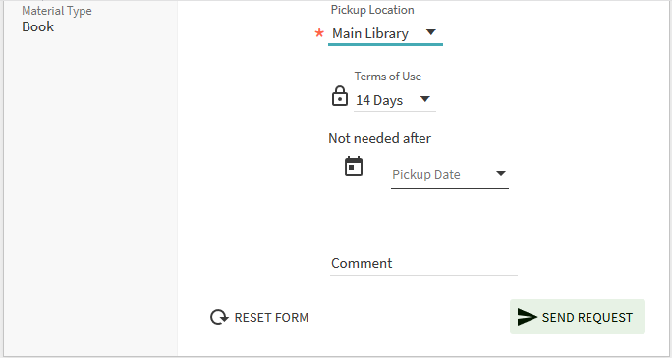
Try it out
She creates the "Request"

Slide 27
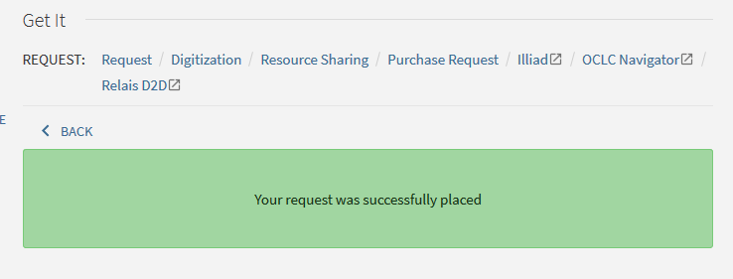
Try it out
The "Request" is placed

Slide 28
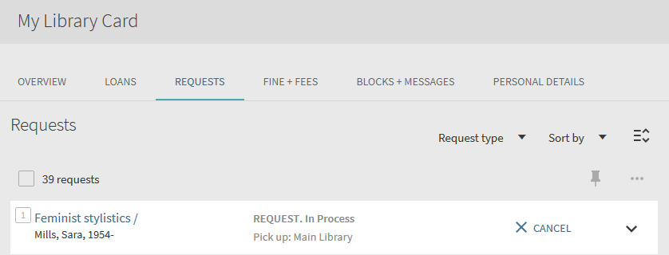
Try it out
The "Request" is created. Works as desired.

Slide 29
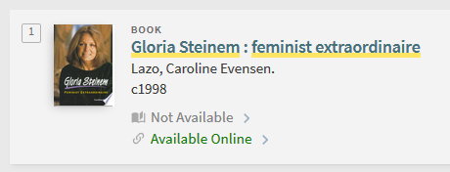
Try it out
User Alicia Chen has logged into Primo and searches for title "Gloria Steinem : feminist extraordinaire" and clicks the physical availability link

Slide 30
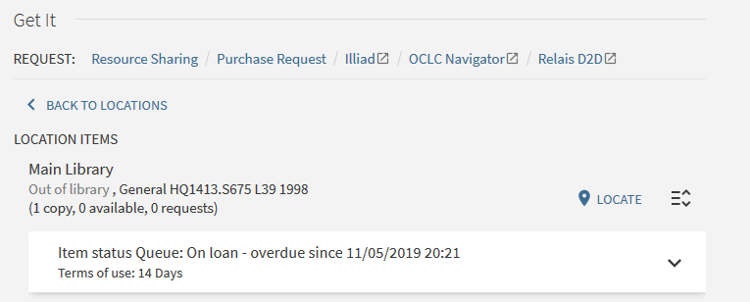
Try it out
There is no option to make a physical item request. Works as desired.
No "Request" link like we had for title "Feminist stylistics"
Item is not in place, it is on loan

Slide 31
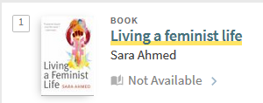
Try it out
User Alicia Chen has logged into Primo and searches for title "Living a feminist life" and clicks the physical availability link

Slide 32
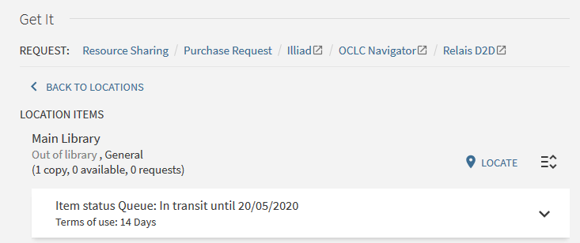
Try it out
There is no option to make a physical item request. Works as desired.
No "Request" link like we had for title "Feminist stylistics"
Item is not in place, it is in transit

Slide 33
Thank you!
xxx@exlibrisgroup.com

